Slide 1
2018 QUANTITATIVE STRATEGY CASE INTERVIEW
By: Traci Lim

Slide 2
Datasets Used
HDB Resale Flat Transactions from year 1990 to 2018
HDB Addresses with Geographical Coordinates
HDB Addresses with Geographical Coordinates
School Addresses and MRT data with Geographical Coordinates
Certificate of Entitlement (COE) Bidding Results

Slide 3
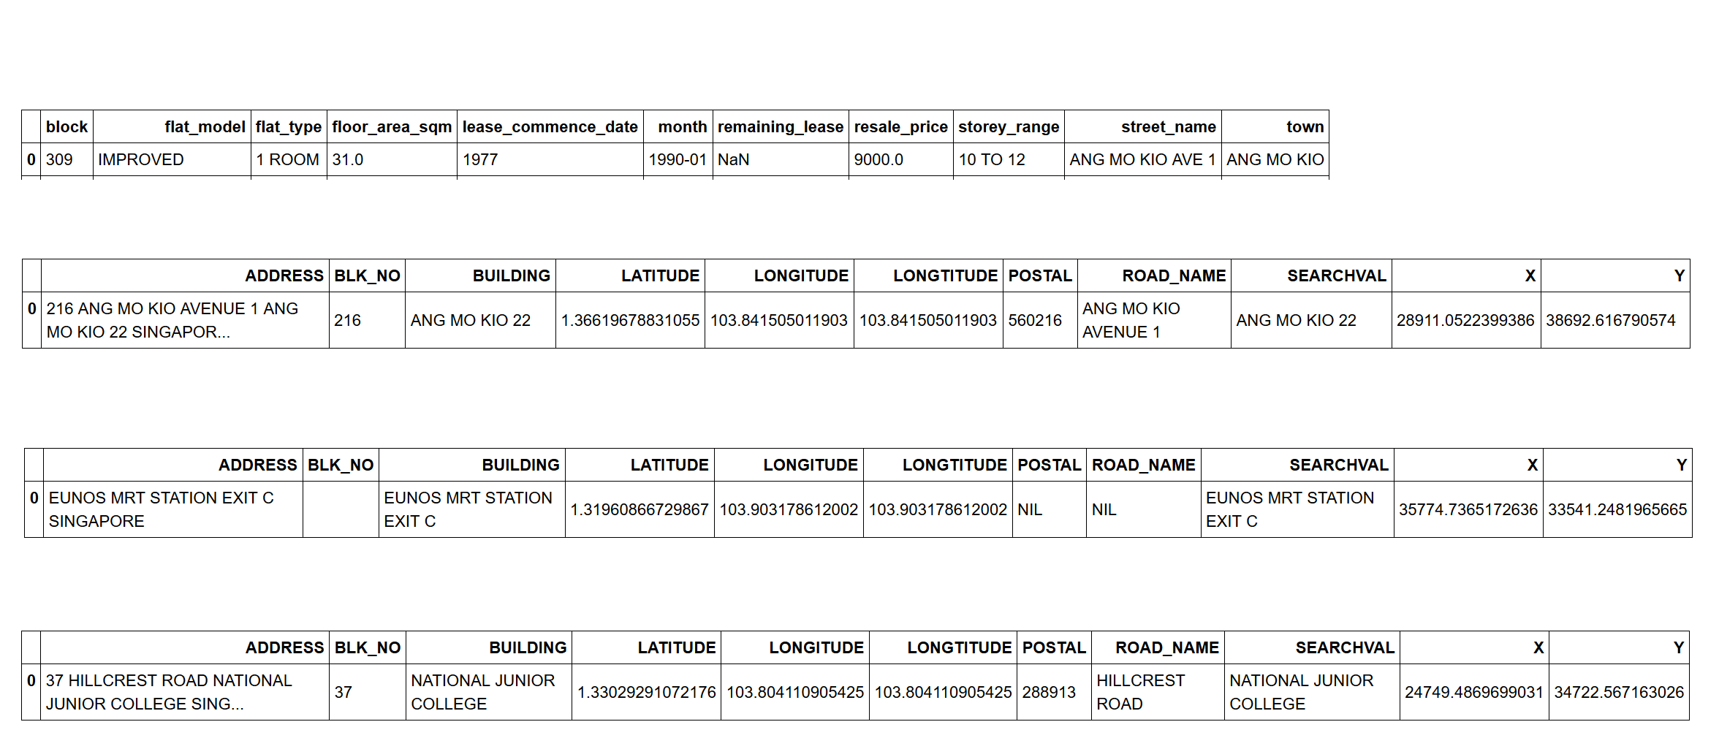
A Peek

Slide 4
Q1: Data Viz
Question 1A:
Show an overview of the number of property transactions, median price across the years.
Provide both a view at the national level, as well as by HDB towns.
Your dashboard should also provide functionality to filter based on Flat Type (e.g. look at only 5 Room flats).
Link to Tableau Dashboard

Slide 5
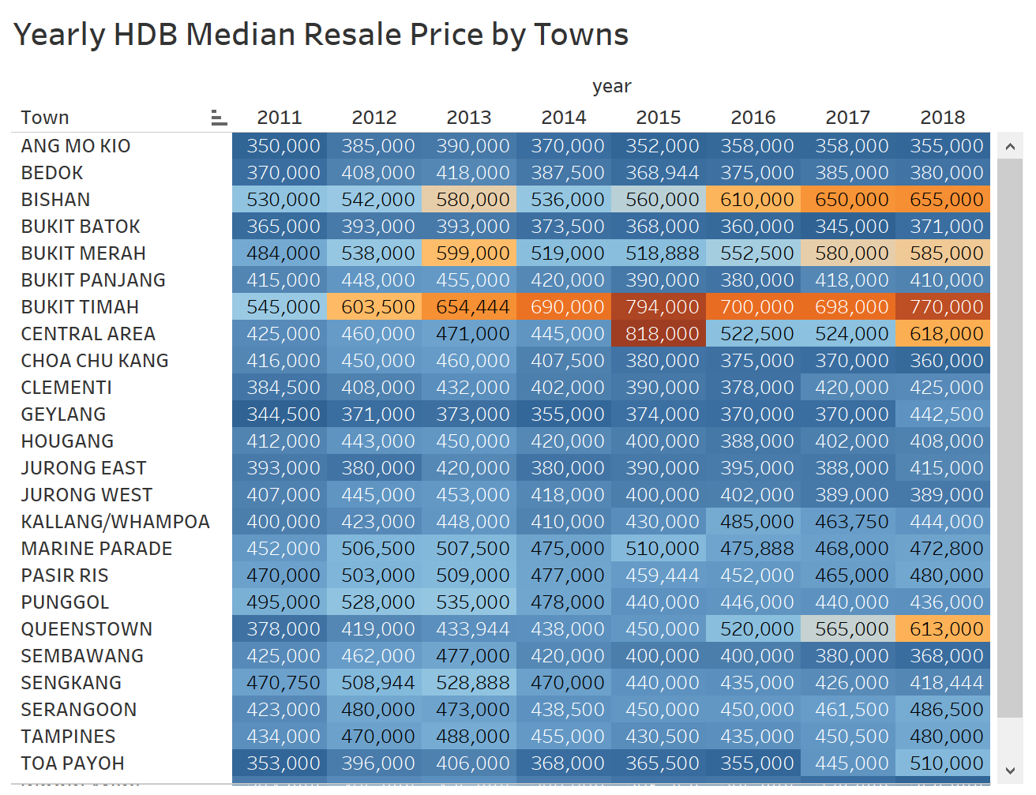
Trends on HDB Resale Prices
Consistently high prices for flats in Bishan and Bukit Timah.
Approx. 2x Jump!

Slide 6
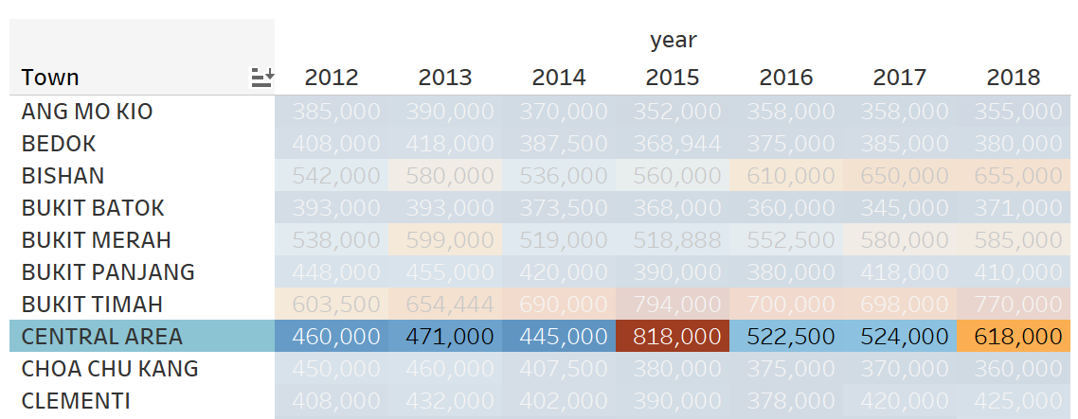
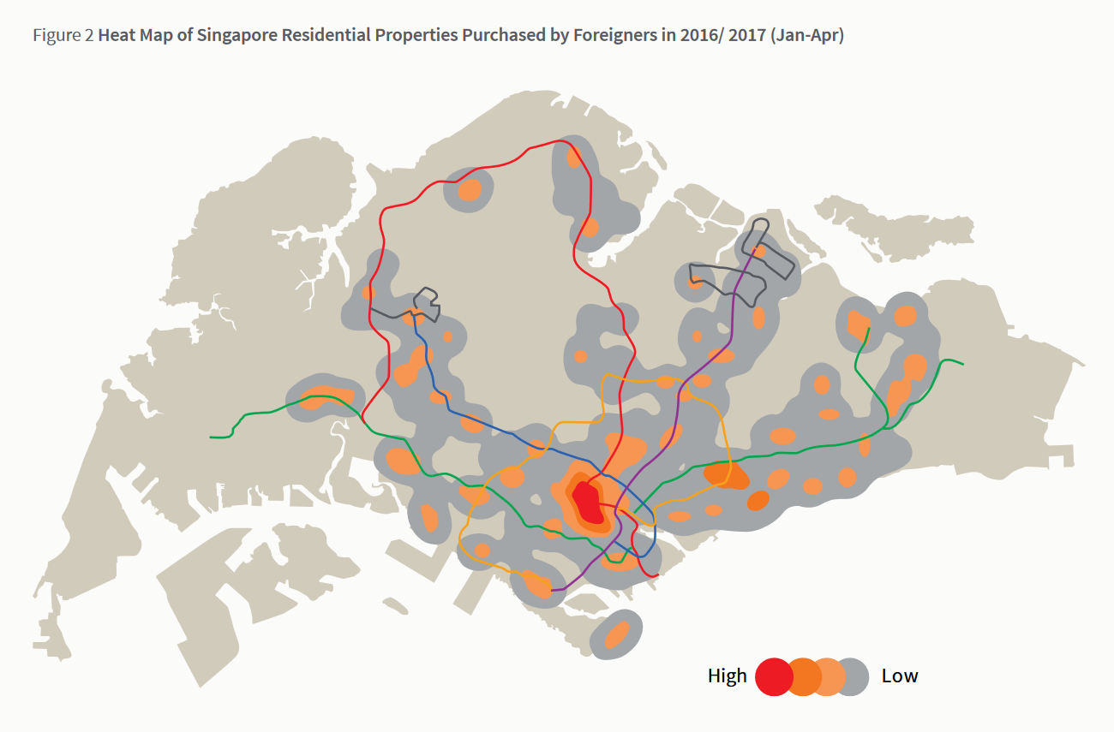
Why 2x Jump?
Report from JLL shows out of 1610 purchases made by foreigners in 2016/2017, 60% were located in Central Area
But foreigners can’t buy HDBs
Could be due to a trickle-down effect
http://www.ap.jll.com/asia-pacific/en-gb/Research/SG-hotspots.pdf?587a0557-2140-49bc-b82c-46b7d96b1df2
Notes:
At least nine other Pinnacle@ Duxton flats have been resold since this became possible last December, when owners began to meet the five-year minimum occupation period.

Slide 7

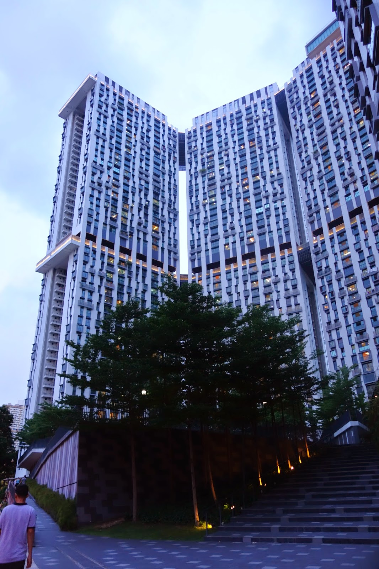
Why 2x Jump?
Pinnacle@duxton is the culprit.
Out of 756 transactions in Central Area for year 2015, 472 are Pinnacle transactions priced above 800,000.
If Pinnacle is car, it would be the Rolls-Royce of HDBs.
Notes:
At least nine other Pinnacle@ Duxton flats have been resold since this became possible last December, when owners began to meet the five-year minimum occupation period.

Slide 8
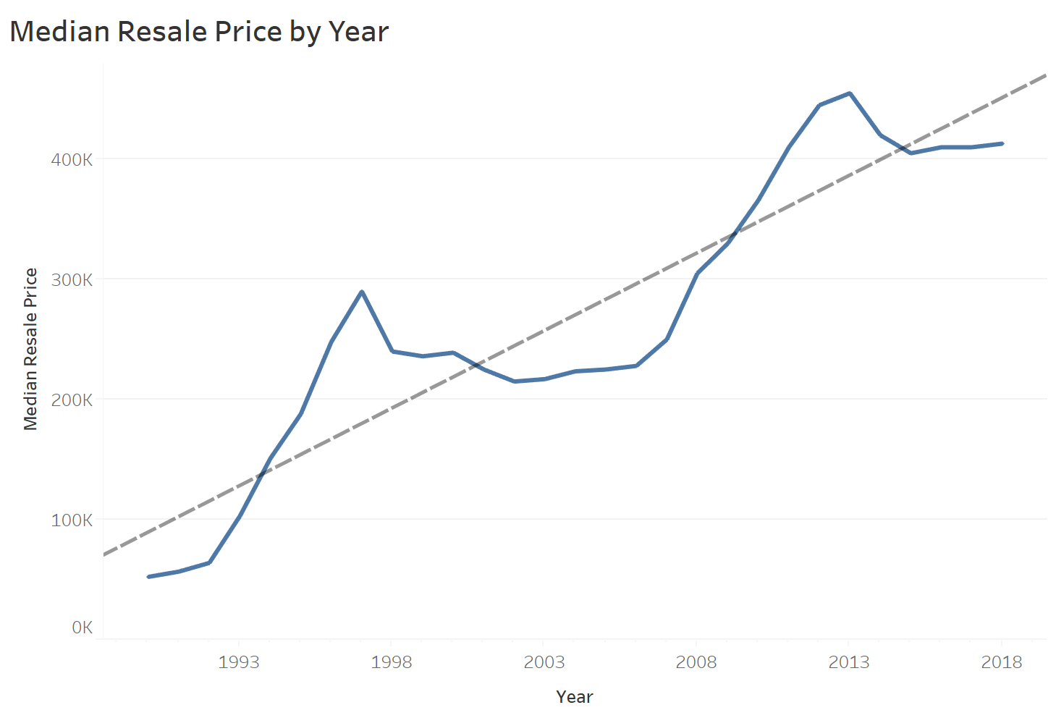
Up and Up and Up
Although prices are not adjusted by inflation, median resale prices have increased by a factor of 4 since 1990.
Notes:
More accurate metric to use is the resale price index.
Look at year 2009 onwards, hdb website shows a similar looking graph with resale price index as the y axis.
the HDB resale price index increased by nearly 50% from early 2009-June 2013, before flatting out and then falling by 10.4% from an index value of 149.4 in June- 2013 to 133.9 in March-2017. HDB InfoWEB

Slide 9
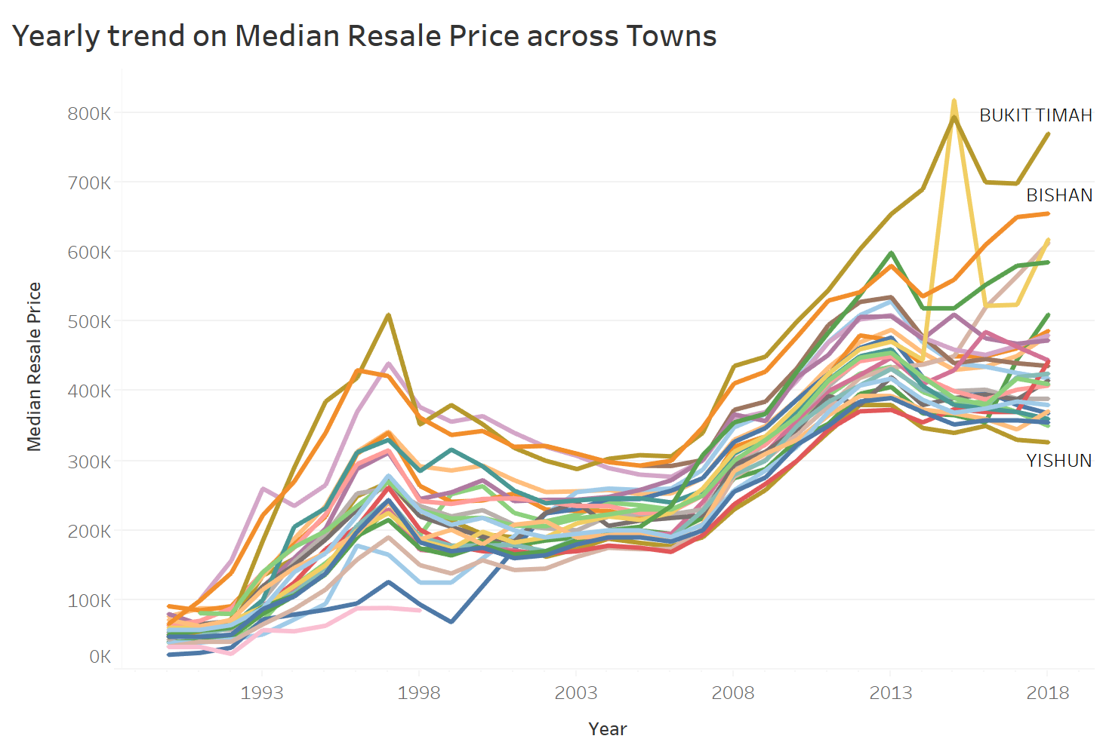
Yearly Trend
2013-2014 Reversal in trend
Central Area

Slide 10
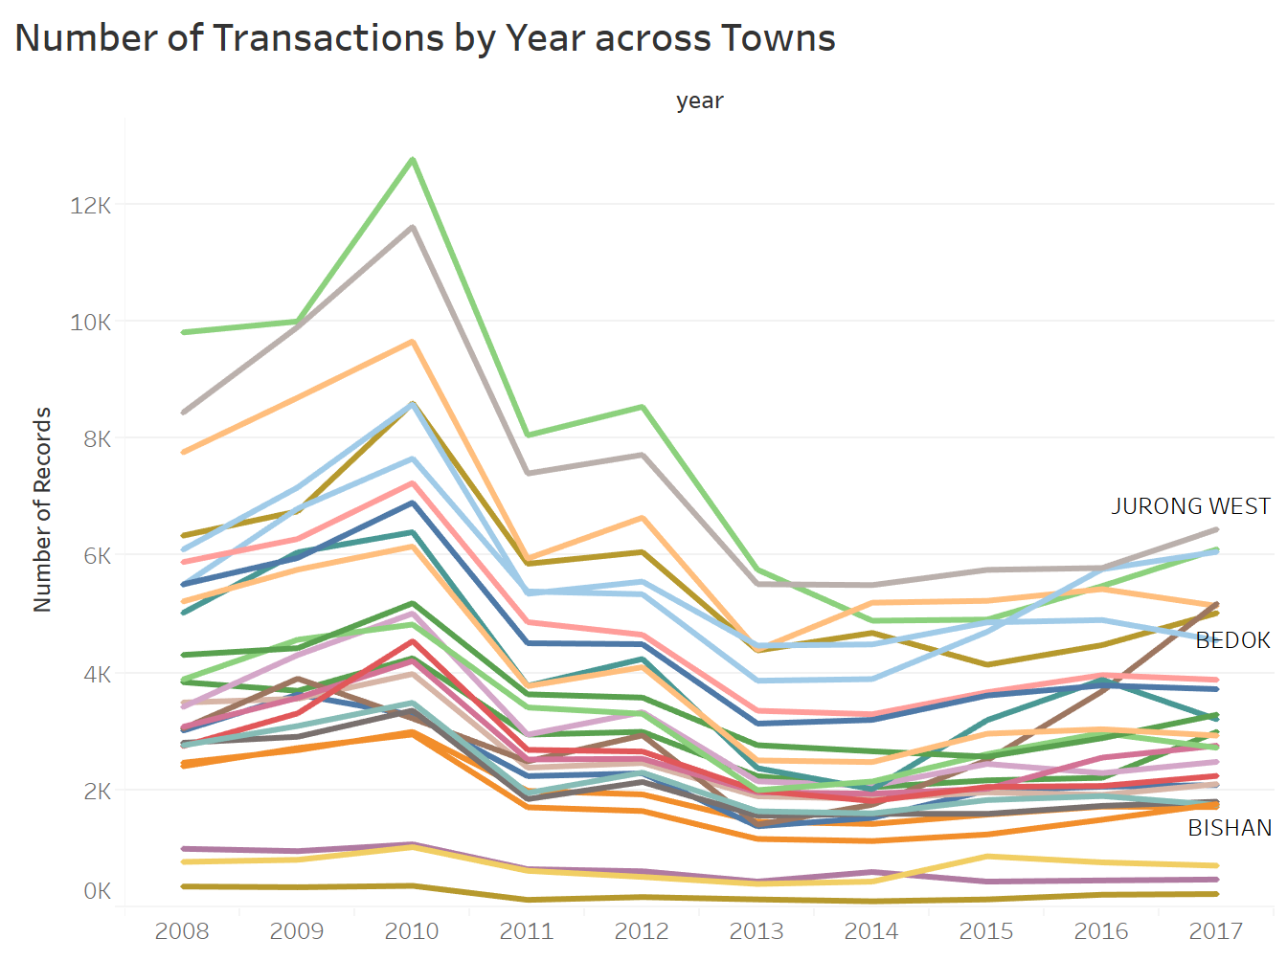
First wave of cooling measures amidst an overheated market
In January 2011, four Singapore property cooling measures were introduced.
Notes:
Introduced in 2013’s cooling measures exercise, the TDSR is meant to limit the amount of debt you can be in, as a ratio of your income. So if you’re making $1,000 a month, you should only be spending $600 on repaying debts. There is no change to TDSR with the 2018 cooling measures.
Formal statistical evaluation of the impacts of Singapore’s individual moves to cool the housing market is challenging for many reasons. the regulations usually were implemented as a policy package over a fairly narrow time frame, often within six months of one another. disentangling the treatment effects of each measure is nearly impossible. difficulty of inferring the causal effects of property market policies.

Slide 11
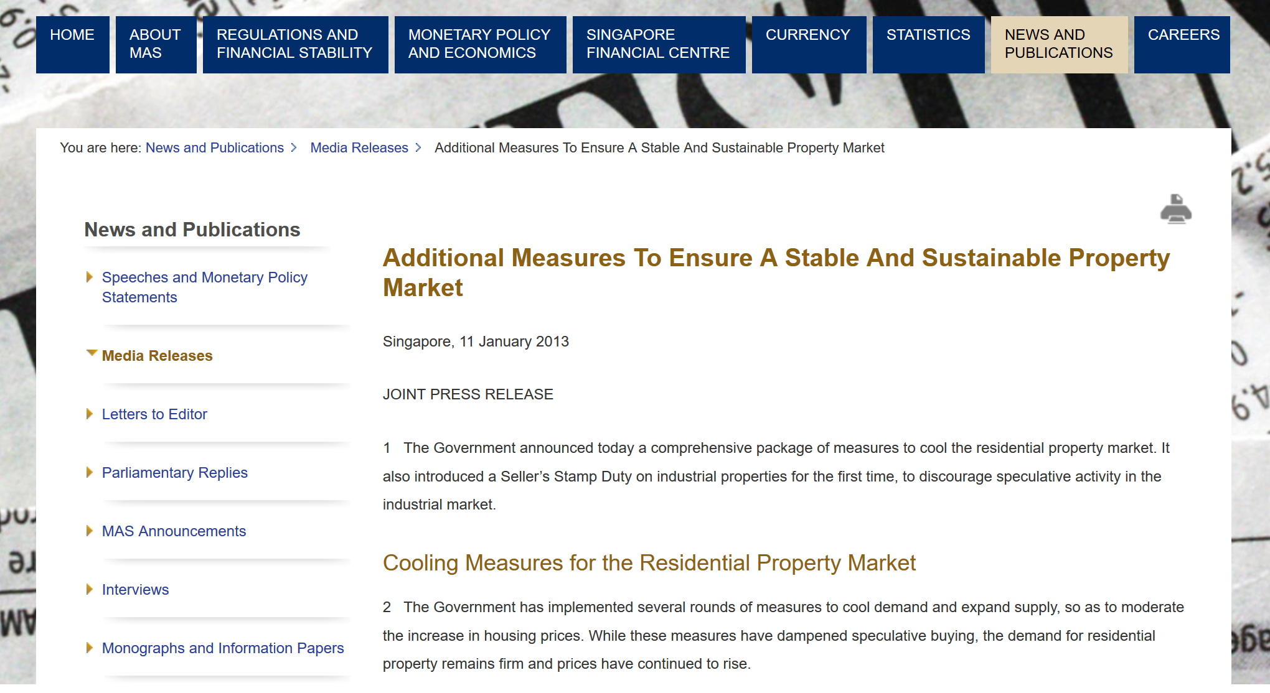
Reversal in trend from 2013 to 2014
http://www.mas.gov.sg/News-and-Publications/Media-Releases/2013/Additional-Measures-To-Ensure-A-Stable-And-Sustainable-Property-Market.aspx
Notes:
The first intervention occurred on September 14, 2009, with the removal of then extant policies to boost the housing market. This was followed by nine other measures that were imposed between February 20, 2010, and December 9, 2013.

Slide 12

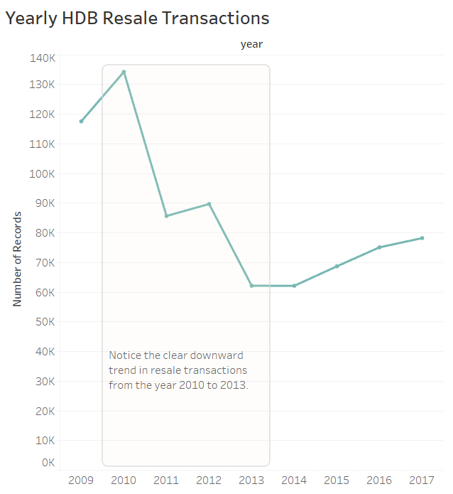
More cooling measures?
10 cooling measures were implemented from Sep 2009 to Dec 2013.
Seller’s Stamp Duty (SSD)
Lowered loan-to-value (LTV) ratio limits
Additional Buyers’ Stamp Duty (ABSD)
Mortgage service ratio (MSR)
Some other stuff…
Notes:
In 2018, more cooling measures introduced- ABSD went up from 7 to 12% for 2nd home buyers, 10 to 15 for 3rd, LTV limits went down.
IOW, home buyers have to pay more taxes, and cannot borrow as much, so downpayment got bigger.
Likely due to the enbloc frenzy over the past year.
Know cooling measures are meant to control private property price inflation, I think in our case, for resale hdb flats, the prices may rise because private properties are less affordable now, many homebuyers would be driven to the hdb resale market.
Total Debt Servicing Ratio (TDSR) ensure that people borrow, and banks lend, responsibly. limits the amount borrowers can spend on debt repayments to 60 percent of their gross monthly income.

Slide 13
Q1: Data Viz
Question 1B**:
Some buyers would want to get the largest flat possible within a given budget.
Create a dashboard to allow potential buyers to input their budget, and then suggest towns where such flats exist based on historical transactions.
Question 1C***:
There are buyers who would like to optimise given the proximity of a flat to important locations in the neighbourhood, such as the nearest MRT station.
Create a dashboard that allows buyers to: i) input their budget; and ii) optimise flat selection given distance to important locations around the neighbourhood.

Slide 14
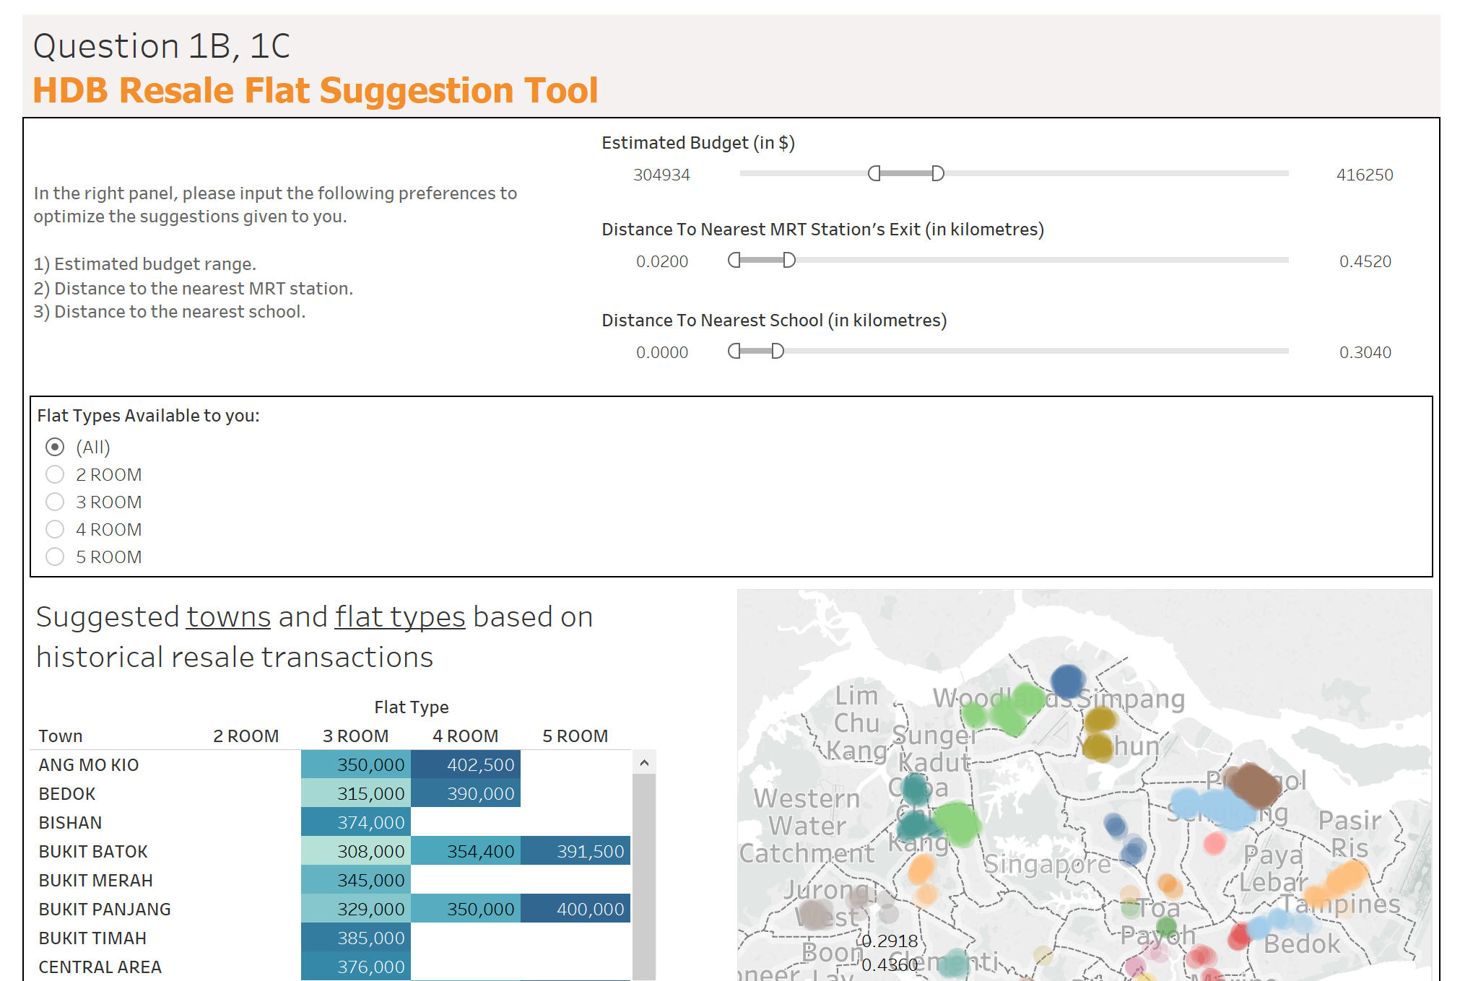

Slide 15

Q2: Data Modeling
HDB wants to know if a resale flat transaction fits market expectations. Your task is to create statistical models to answer the following questions.
Question 2A*: Predict a resale flat transaction price in 2014. Use the following characteristics: flat type, flat age and town. Propose and implement a minimum of three models, select the best model, and explain the reasons for your choice.

Slide 16
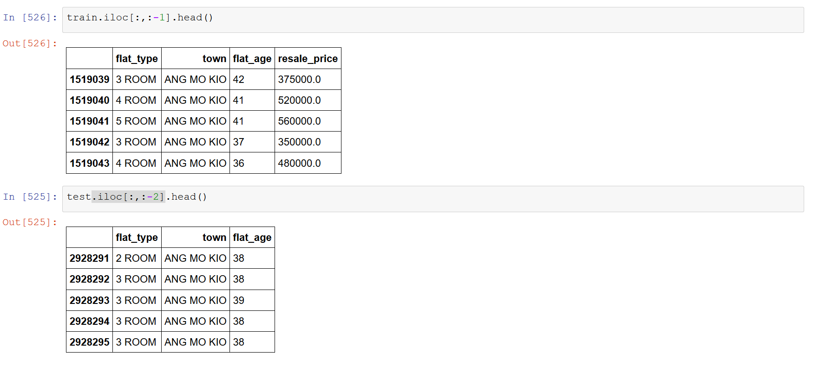
Predicting Resale Price with 3 Features

Slide 17
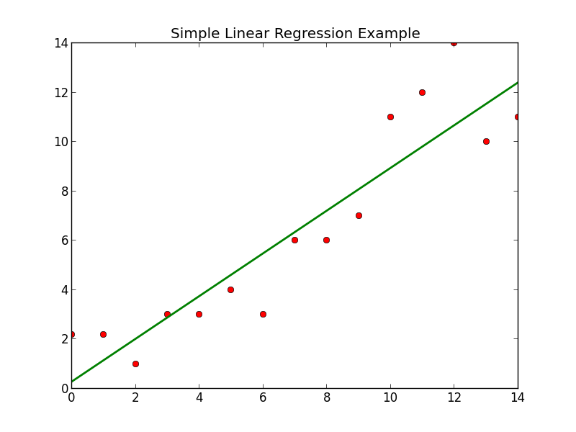
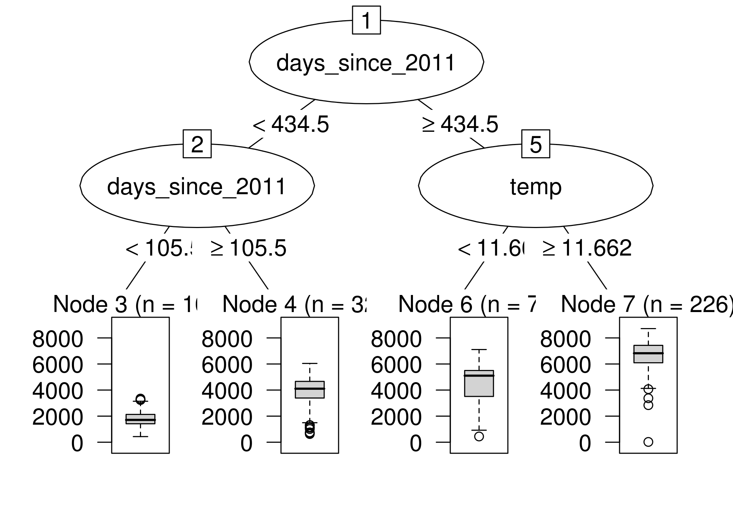
Models used
Linear Regression with Regularization (Elastic Net)
Simple
Easy to understand
Decision Trees (Regression)
Simple
Good when there are lots of categorical variables
Can capture non-linear relationships
LightGBM (Microsoft’s Gradient Boosting Algorithm)
Fast
Cutting Edge
Mega-improved version of decision trees

Slide 18
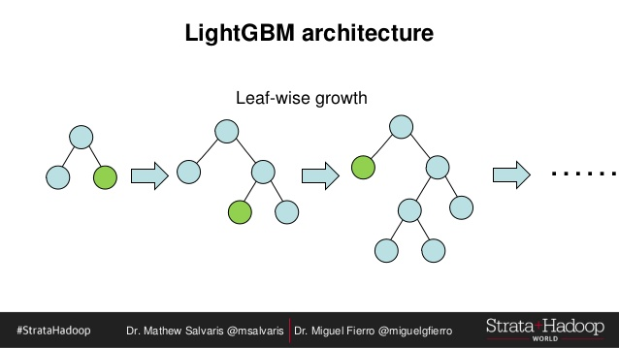
What is LightGBM?
LightGBM (Microsoft’s Gradient Boosting Algorithm)
Fast (took 3 seconds)
Cutting Edge
Mega-improved version of decision trees

Slide 19
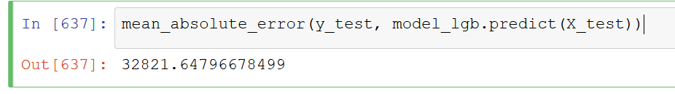
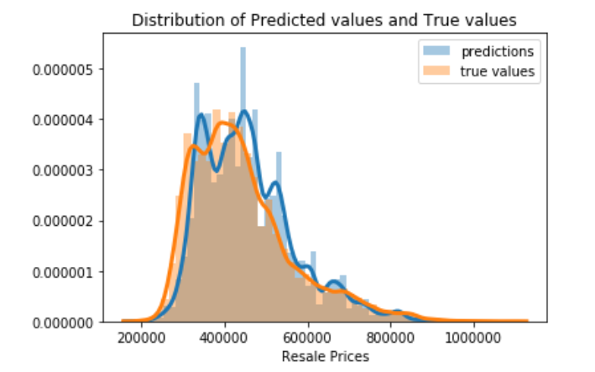
Every prediction is $33,000 off on average
This is one of the cases where Tree models > Linear models.
MAE tells us how big of an error we can expect from the predicted value on average.
Notes:
linear regression needs the relationship between the independent and dependent variables to be linear, requires all variables to be multivariate normal, little or no multicollinearity in the data, homoscedasticity in which the error term is the same across all values of the independent variables.

Slide 20
Q2: Data Modeling
Question 2B**: A flat was sold in Nov 2017 with the following characteristics:
Flat type: 4 ROOM
Town: Yishun
Flat Model: New Generation
Storey Range: 10 to 12
Floor Area (sqm): 91
Lease Commence Date: 1984
Resale Price: 550,800
Was this a reasonable price for the transaction? How confident are you in your assessment?

Slide 21
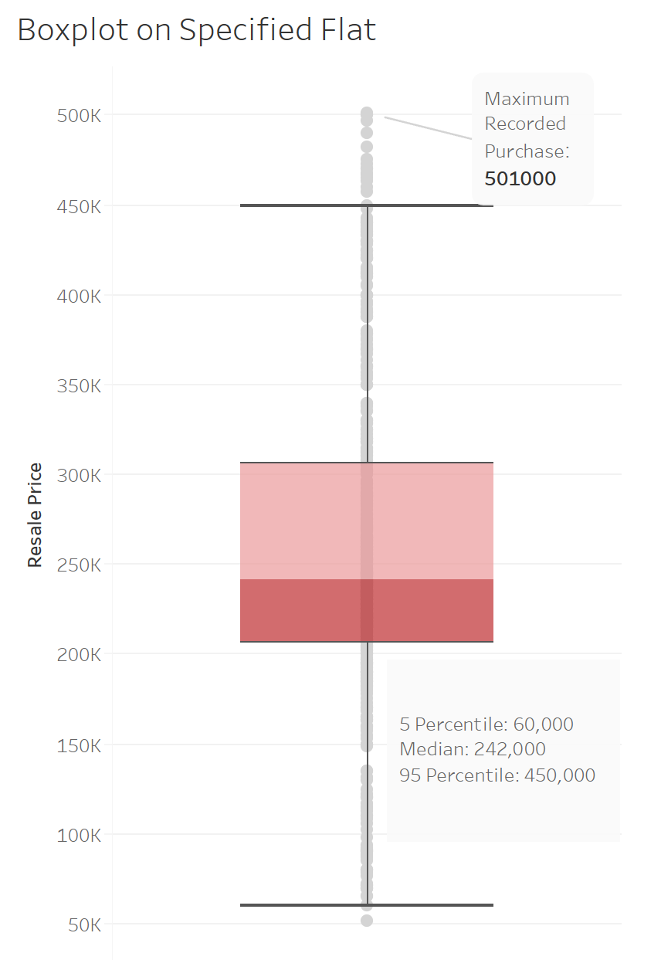
Highly overpriced transaction
The word ‘reasonable’ is highly subjective, since the transaction consists of a willing buyer and seller
Must be good fengshui

Slide 22

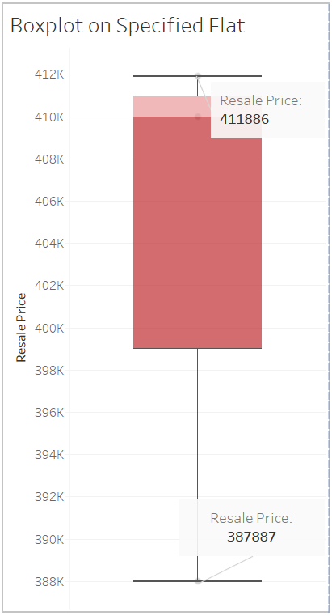
Highly overpriced transaction
The word ‘reasonable’ is highly subjective, since the transaction consists of a willing buyer and seller
Must be good fengshui

Slide 23
Predicting Flat Types
Question 2C***: Someone mistakenly deleted the column containing data on Flat Type in the database from 2015 onwards. While backups exist, these data are critical to HDB’s daily operations, and time would be needed to restore these data from the backup. Senior management would like you to create a model to predict flat type given a transaction’s other characteristics. Explain the reasons for choosing this model.

Slide 24
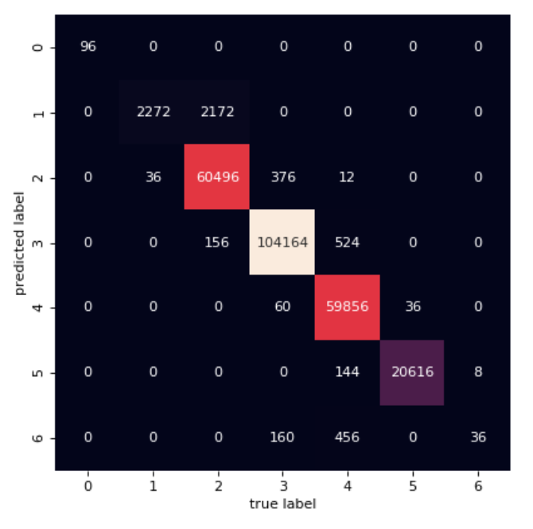
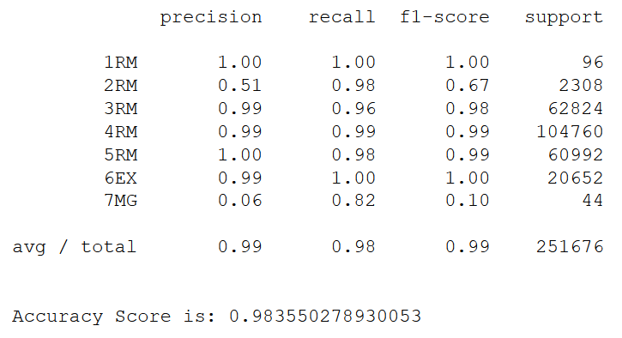
Model correctly predicts flat type 98% of the time
Confusion Matrix

Slide 25
Q3: Policy Analysis
Question 3A*:
Yishun has received a negative reputation as “Crazy Town”, and property prices might have been impacted. Are Yishun flats the cheapest in the country?

Slide 26
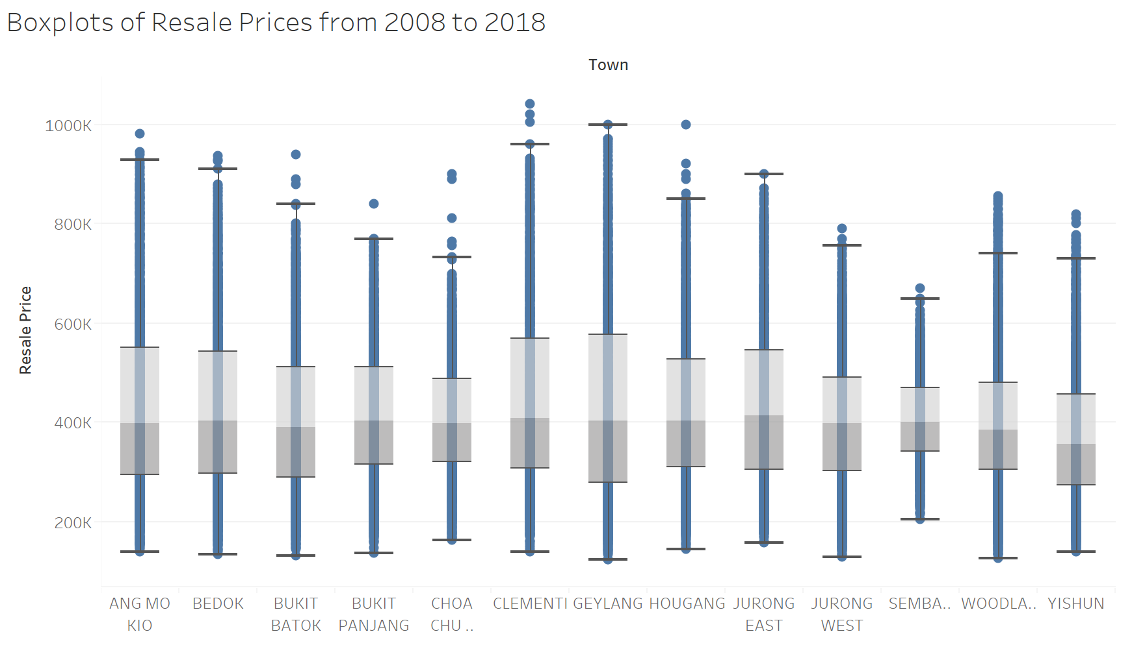
Can’t Beat Yishun Cheap Prices

Slide 27
Q3: Policy Analysis
Question 3B*:
Some members of public have been saying that flat sizes have gotten smaller over the years. Is there any truth in this statement?

Slide 28
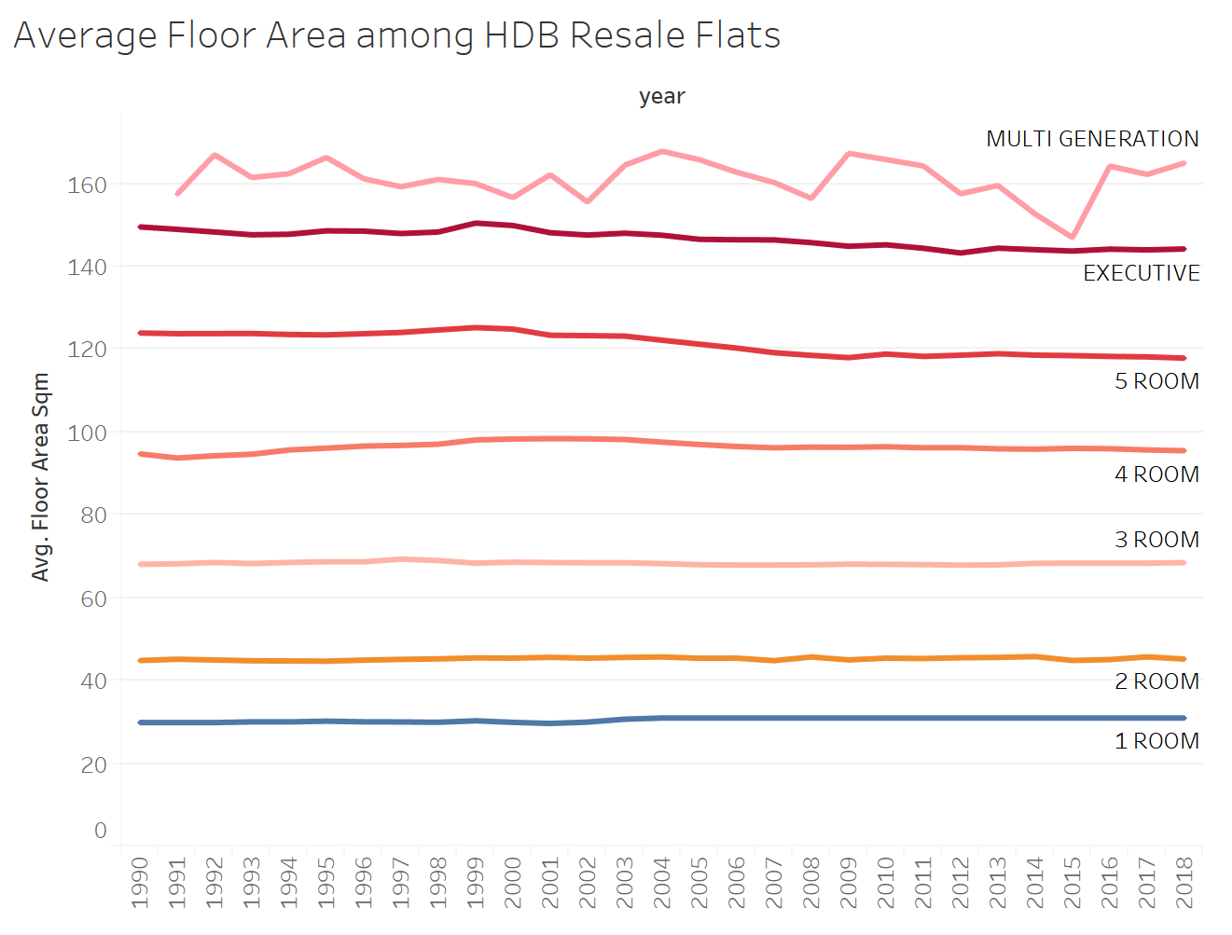
Nearly Parallel lines
Near-constant trend

Slide 29
Q3: Policy Analysis
Question 3C**:
The Downtown Line Stage 2 connects the Bukit Panjang heartland to the city. Have prices increased for resale flats in the towns served by this Line? You might want to use a difference-in-differences model for this task.

Slide 30

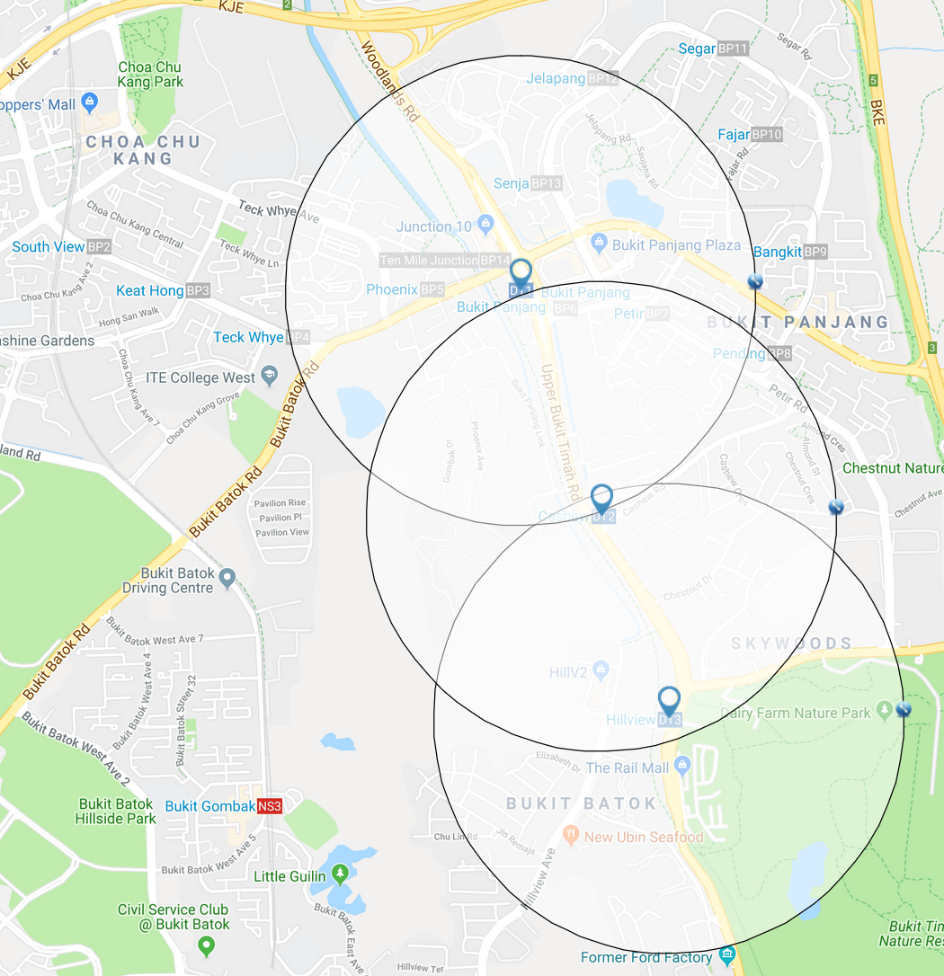
Difference-in-Differences Model
Used to estimate causal effects of the opening of Singapore's Downtown Line
Two groups: Control and Treatment
Control group: Flats outside 1km radius of any DTL station
Treatment group: Flats within 1km radius of any DTL station

Slide 31

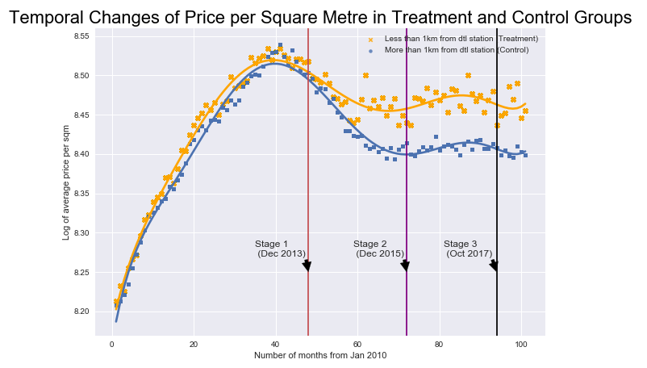
Did Opening of DTL affect Average Price per Sqm of HDB Resale Flats?
Notes:
House prices (and their changes) may have complex and lagged effects that our tests and data simply cannot identify.
Singapore’s birth rate could also impact public housing: birth rates trended down since 1988, they have many choices, BTO, new and resale private housing, ec,.
Ageing HDB flats, which are sold on 99 year leases could also affect resale prices. More than 400k flats are left with 69 years or less remaining on their lease.
The curve down is likely due to the rapid firing of 10 cooling measures that spanned from 2009 to 2013.
I believe it is due to the SIBOR (Singapore interbank offered rate). Most banks in sg offer SIBOR-based home loan packages.
Beginning in around 2009, the SIBOR hit historic lows. This made home loans very cheap, which was obviously good news for homebuyers. The SIBOR trend was stable for so many years that many homebuyers didn't think twice about signing up for floating rate home loan packages.
The US Federal Reserve has raised interest rates four times since late 2016, which caused the SIBOR and SOR to rise in tandem
People will be switching to fixed rate home loans, can stop getting a heart attack everytime interest rates rise. Or will be refinancing to a shorter term loan. Adhering to the TDSR rules require that the sum of all your loan repayments (your home loan + any car loan, education loan, credit card debt, personal loan etc) do not exceed 60 per cent of your income.

Slide 32

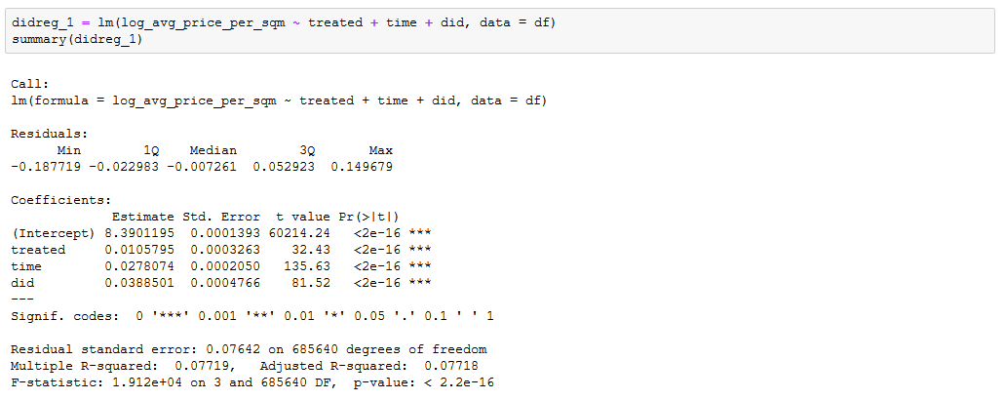
Estimating the DiD estimator
Helped to increase average price per sqm of flats near a DTL station by 3.9%.
But the average price per sqm of flats was experiencing a 2.8% growth after the opening of DTL, regardless of its proximity to a DTL station.

Slide 33
Q3: Policy Analysis
Question 3D***:
There have been comments online that people are buying flats in towns further from the city so that the cost savings can be used for a car.
Are resale prices in HDB estates in areas further away from the city (i.e. Sengkang and Punggol) impacted by Certificate of Entitlement (COE) prices for cars?

Slide 34
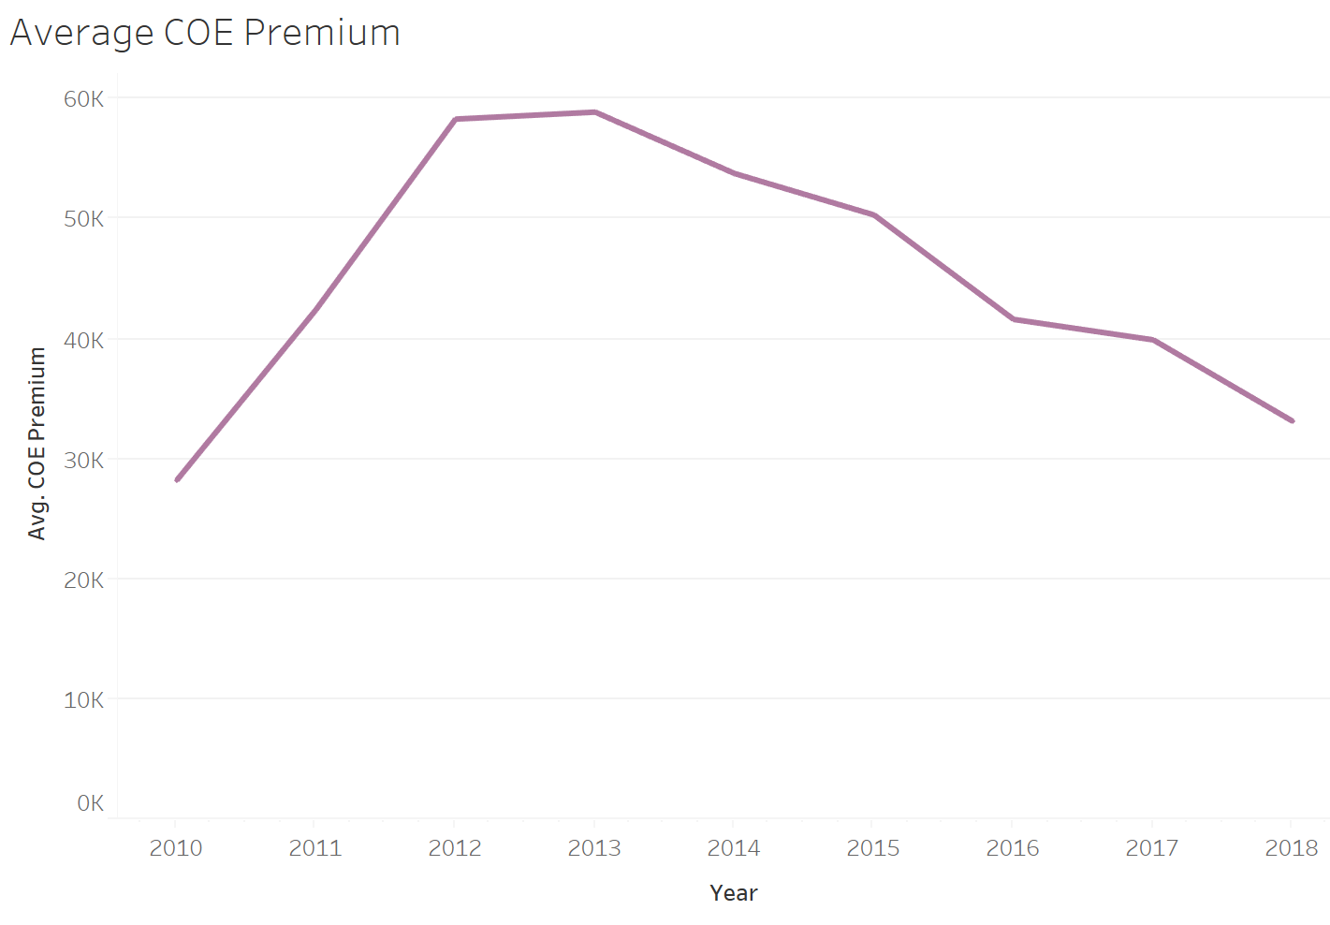
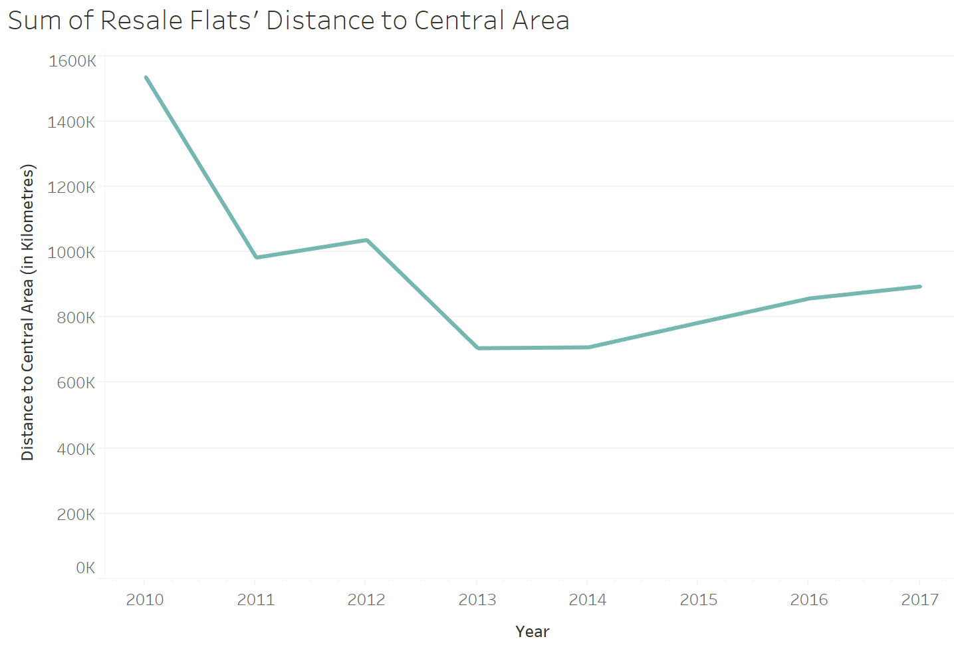
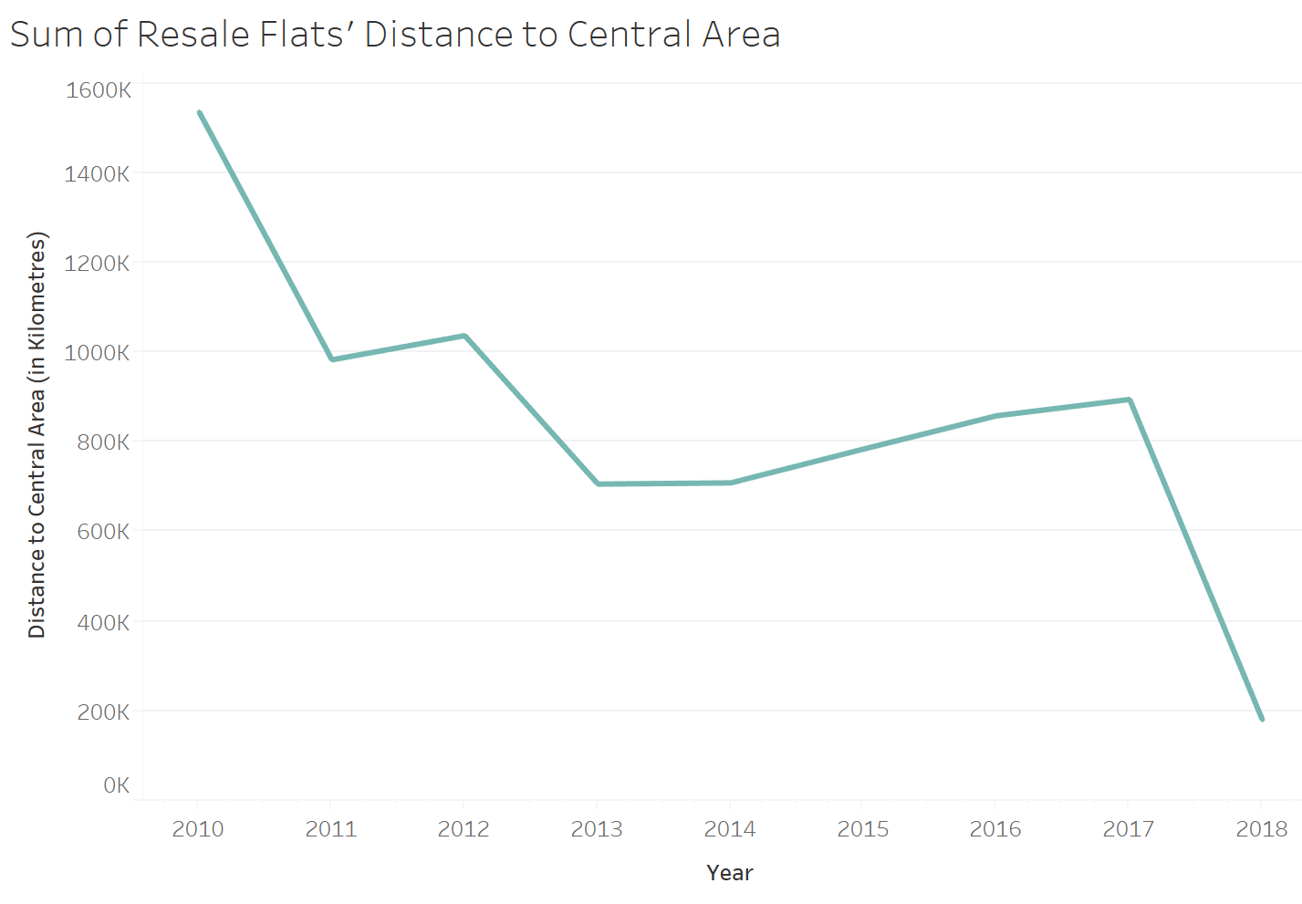
About COE Prices
COE prices are determined by the interaction of demand and supply.

Slide 35

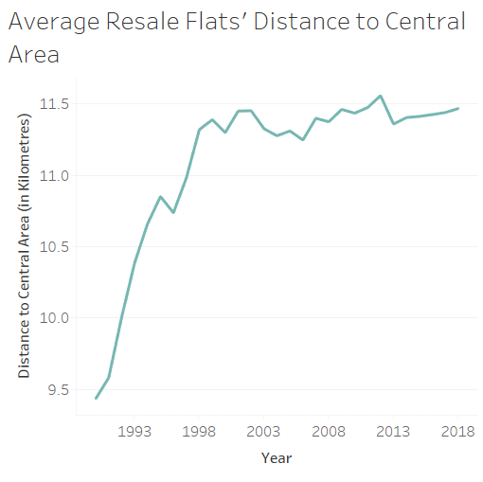
Flats bought are further away to central area
Flats purchased are further away from central region

Slide 36

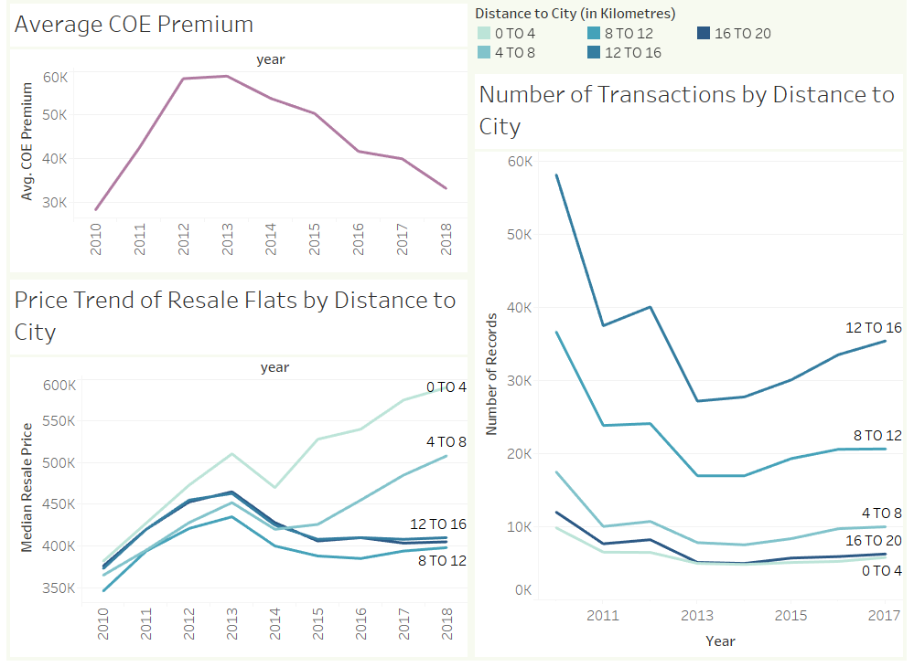
Q3D: Looking at Resale Prices and COE
Sengkang and Punggol fall in the 12 to 16 km mark.
Price trend of flats that are 8 to 20 km away from the city actually follows a similar pattern with COE prices.

Slide 37
End.

